Slide 1

QT Chart
QT6 C++ 开发教程
第14章

Slide 2
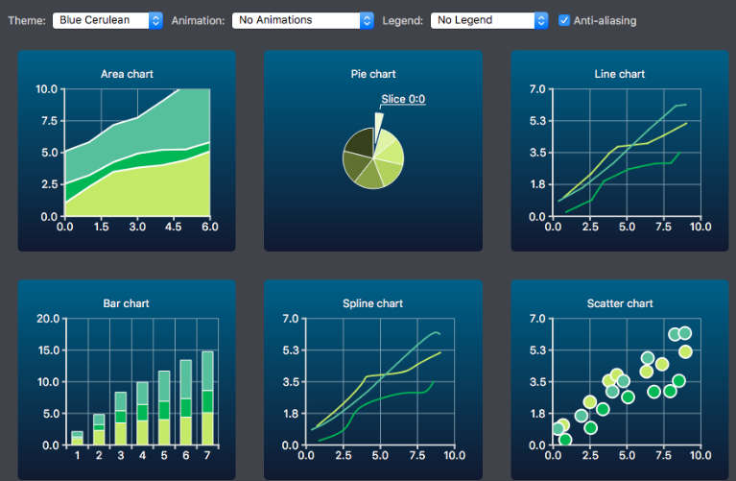
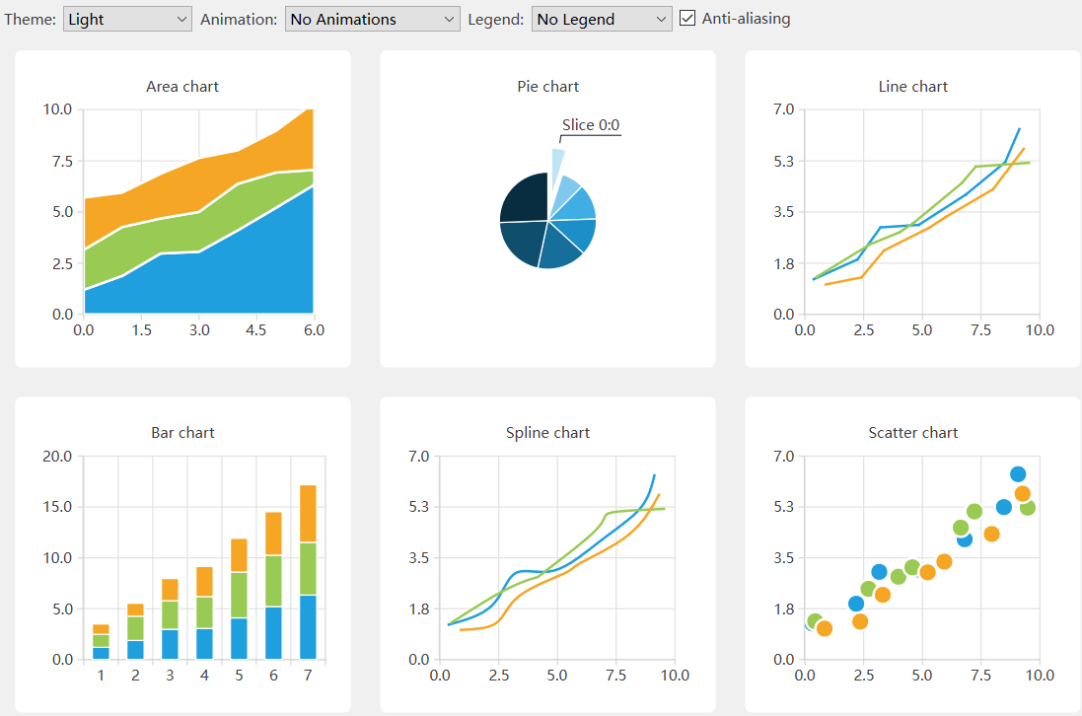
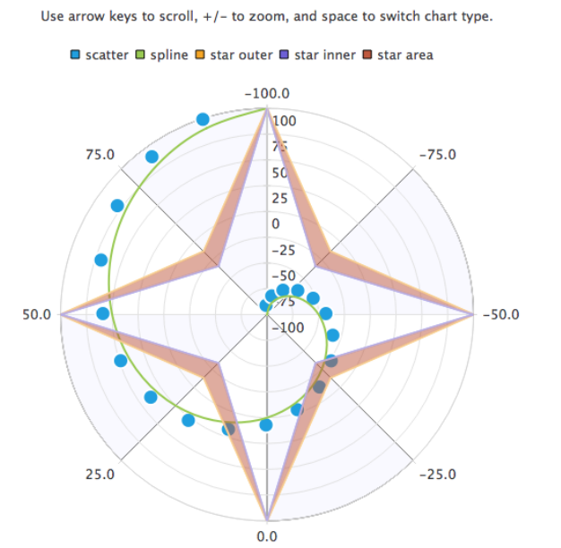
Qt Charts概述
Qt图表支持创建时尚、交互式、以数据为中心的用户界面。
QChart类管理不同类型的数据（series）和其他图表相关对象，如图例（legend）和轴（axes）的图形表示。
Qt图表模块提供如下类型：
折线图
样条曲线图
面积图
散点图
条形图
饼图
方块胡须图
蜡烛图
极坐标图
每个图表数据类型都由一个QAbstractSeries派生类表示。图表是通过使用series类的实例并将其添加到QChart实例来创建的。
QAbstractSeries
QLineSeries *series = new QLineSeries();//数据
…… QChart *chart = new QChart();//图表
chart->addSeries(series);
…… QChartView *chartView = new QChartView(chart);//视图
QXYSeries
QLineSeries
CMake：使用find_package命令在Qt6包中查找所需的模块组件：
find_package(Qt6 REQUIRED COMPONENTS Charts)
target_link_libraries(mytarget PRIVATE Qt6::Charts)
qmake：该模块作为QT变量的值添加到项目的中：
QT += charts
Qt Charts官方Reference文档

Slide 3
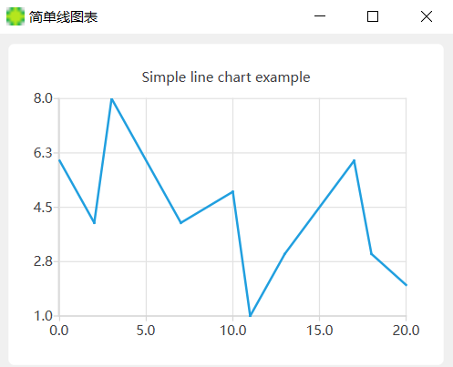
简单的折线图
#include "mainwindow.h" #include <QApplication>
#include <QChartView>
#include <QLineSeries> int main(int argc, char *argv[]) {
QApplication a(argc, argv);
MainWindow w;
w.setWindowTitle("简单折线图");
//数据归chart管，显示的好不好看归View管
QLineSeries *series=new QLineSeries();//创建了一个折线图数据系列
//向数据系列添加一些数据点
series->append(0, 6);
series->append(2, 4);
series->append(3, 8);
series->append(7, 4);
series->append(10, 5);
*series << QPointF(11, 1) << QPointF(13, 3) << QPointF(17, 6)
<< QPointF(18, 3) << QPointF(20, 2);
//要显示就必须将此数据系列添加到图标中进行可视化
QChart *chart = new QChart();//图表
chart->addSeries(series);//添加数据到图标
chart->legend()->hide();//将图例隐藏，并且将图例隐藏。
chart->createDefaultAxes();//用于在图表中创建默认的坐标轴
chart->setTitle("Simple line chart example");
QChartView *chartView=new QChartView(chart);//视图 显示数据
chartView->setRenderHint(QPainter:: Antialiasing);//告诉画家打开抗锯齿
w.setCentralWidget(chartView);//显示在中央控件中
w.resize(400,300);
w.show();
return a.exec();}

Slide 4
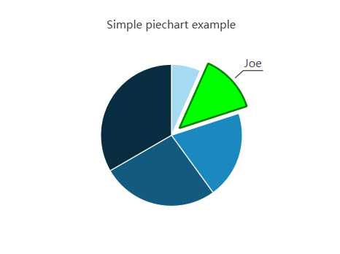
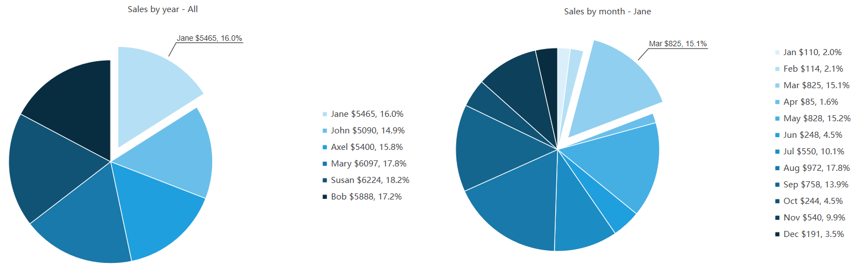
简单的饼状图图
QPieSeries *series = new QPieSeries();
series->append("Jane", 1);
series->append("Joe", 2);
series->append("Andy", 3);
series->append("Barbara", 4);
series->append("Axel", 5);
QPieSlice *slice = series->slices().at(1);
slice->setExploded();
slice->setLabelVisible();
slice->setPen(QPen(Qt::darkGreen, 2));
slice->setBrush(Qt::green);
QChart *chart = new QChart();
chart->addSeries(series);
chart->setTitle("Simple piechart example");
QChartView *chartView = new QChartView(chart);
有层次的饼状图
点击
通过饼状图展示每个业务员的销售业绩：
第一层：展示所有业务员全年的销售总额，按比例划分pie的大小。
第二层：展示每个业务员12个月的详细数据。按比例划分pie的大小。
通过点击第一层中的pie，可以跳转到该业务员的详细数据。
通过点击第二层中的任意pie，可以回到第一层。

Slide 5
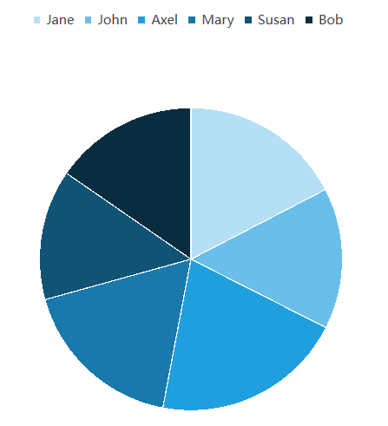
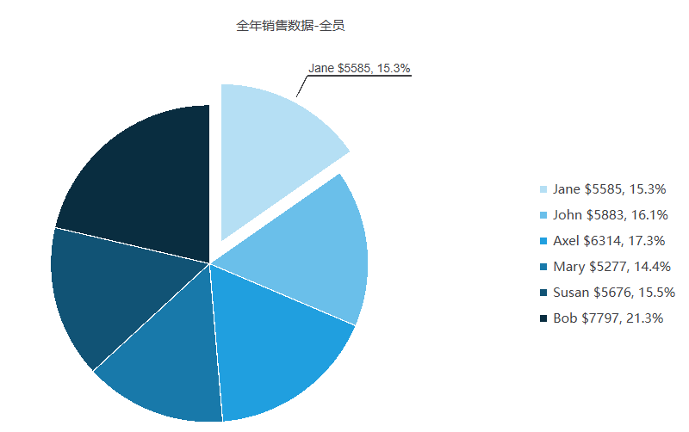
第一步：生成所有业务员的销售额数据，随机每个月的值，并统计全年的值。
每个业务员需要13份数据（12个月+全年总额），使用qt内置的QPieSlice和QChart
int main(int argc, char *argv[]) {
QApplication a(argc, argv);
MainWindow w; const QStringList months =
{ "Jan", "Feb", "Mar", "Apr", "May", "Jun", "Jul", "Aug", "Sep", "Oct", "Nov", "Dec" };
const QStringList names = { “Jane”, “John”, “Axel”, “Mary”, “Susan”, “Bob” }; //在总表中，每个人一个pie(yearseries) QPieSeries *yearSeries = new QPieSeries(&w);
yearseries->setName("全年销售数据-全员");
QChart *chart = new QChart();
chart->addSeries(yearseries);
for(const auto &name:names){
//在个人表中，每个月一个pie(monthseries)
QPieSeries *monthSeries = new QPieSeries(&w);
monthSeries->setName("月销售数据 - " + name);
for(const auto &month:months){
*monthSeries<<new QPieSlice(month,QRandomGenerator::global()->bounded(1000),&w);
}
//series->sum()返回每个业务员的销售总额（value之和）.
*yearseries<<new QPieSlice(name,monthSeries->sum(),&w);
}
QChartView *chartView = new QChartView(chart);
w.setCentralWidget(chartView);
w.resize(800, 500); w.show(); return a.exec();
}
第二步：生成自定义的DrilldownSlice替换掉QPieSlice并将数据文字显示放到右边：
QChart *chart = new QChart();
chart->setTitle(yearSeries->name());
chart->setTheme(QChart::ChartThemeLight);
chart->setAnimationOptions(QChart::AllAnimations);
chart->legend()->setVisible(true);
chart->legend()->setAlignment(Qt::AlignRight);
chart->addSeries(yearSeries);
…
*monthSeries<<new DrilldownSlice(QRandomGenerator::global()->bounded(1000), month, yearSeries);
…
*yearSeries<<new DrilldownSlice(monthSeries->sum(), name, monthSeries);

Slide 6
DrilldownSlice
#include <QPieSlice> class QAbstractSeries; class DrilldownSlice : public QPieSlice
{
Q_OBJECT
public:
DrilldownSlice(qreal value, QString prefix, QAbstractSeries *drilldownSeries);
QAbstractSeries *drilldownSeries() const;
public Q_SLOTS:
void updateLabel();
void showHighlight(bool show);
private:
QAbstractSeries *m_drilldownSeries;
QString m_prefix;
};
DrilldownSlice::DrilldownSlice(qreal value, QString prefix, QAbstractSeries *drilldownSeries)
: m_drilldownSeries(drilldownSeries), m_prefix(prefix)
{
setValue(value);
updateLabel();
setLabelFont(QFont("Arial", 8));
connect(this, &DrilldownSlice::percentageChanged, this, &DrilldownSlice::updateLabel);
connect(this, &DrilldownSlice::hovered, this, &DrilldownSlice::showHighlight);
}
QAbstractSeries *DrilldownSlice::drilldownSeries() const { return m_drilldownSeries; }
void DrilldownSlice::updateLabel()
{
QString label = m_prefix; label += " $";
label += QString::number(this->value());
label += ", ";
label += QString::number(this->percentage() * 100, 'f', 1); label += "%";
setLabel(label);
}
void DrilldownSlice::showHighlight(bool show)
{
setLabelVisible(show);
setExploded(show);
}

Slide 7
第三步：生成自定义的DrilldownChart替换掉QChart，并添加connect
DrilldownChart *chart = new DrilldownChart();
……
chart->changeSeries(yearseries);
for(const auto &name:names){
QPieSeries *monthseries = new QPieSeries(&w);
monthseries->setName("月销售数据 - " + name);
for(const auto &month:months){
//个人月数据pie里存着年数据的指针
*monthseries<<new DrilldownSlice(QRandomGenerator::global()->bounded(1000),
month, yearseries);
QObject::connect(monthseries, &QPieSeries::clicked,
chart, &DrilldownChart::handleSliceClicked);
}
//series->sum()返回每个业务员的销售总额（value之和）.
//个人年数据pie里存着个人月数据的指针
*yearseries<<new DrilldownSlice(monthseries->sum(), name, monthseries);
QObject::connect(yearseries, &QPieSeries::clicked, chart, &DrilldownChart::handleSliceClicked);
}
main
#include <QChart> class QAbstractSeries;
class QPieSlice; class DrilldownChart : public QChart
{
Q_OBJECT
public:
explicit DrilldownChart(QGraphicsItem *parent = nullptr, Qt::WindowFlags wFlags = {}); void changeSeries(QAbstractSeries *series);
public Q_SLOTS:
void handleSliceClicked(QPieSlice *slice);
private:
QAbstractSeries *m_currentSeries;
};
DrilldownChart

Slide 8
DrilldownChart::DrilldownChart(QGraphicsItem *parent, Qt::WindowFlags wFlags)
: QChart(QChart::ChartTypeCartesian, parent, wFlags), m_currentSeries(0)
{ }
void DrilldownChart::changeSeries(QAbstractSeries *series) {
// NOTE: if the series is owned by the chart it will be deleted
// here the "window" owns the series...
if (m_currentSeries) removeSeries(m_currentSeries);
m_currentSeries = series;
addSeries(series);
setTitle(series->name());
}
void DrilldownChart::handleSliceClicked(QPieSlice *slice) {
DrilldownSlice *drilldownSlice = static_cast<DrilldownSlice *>(slice);
changeSeries(drilldownSlice->drilldownSeries());
}
点击

Slide 9
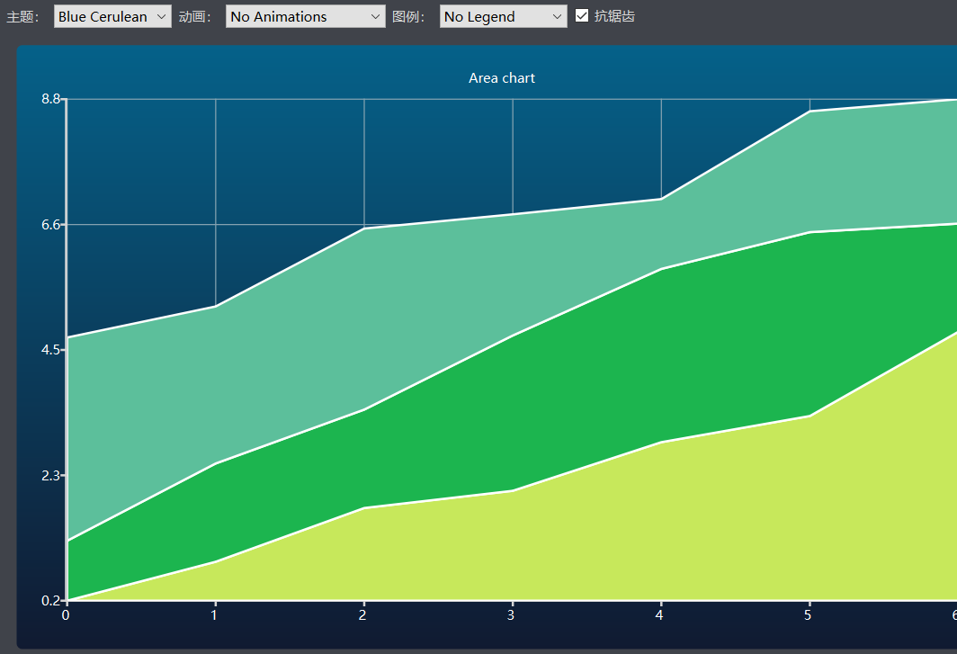
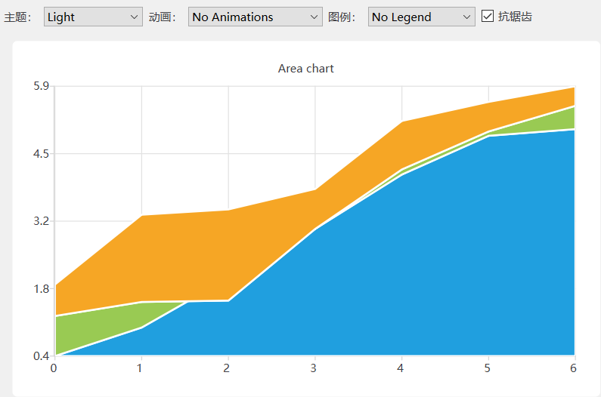
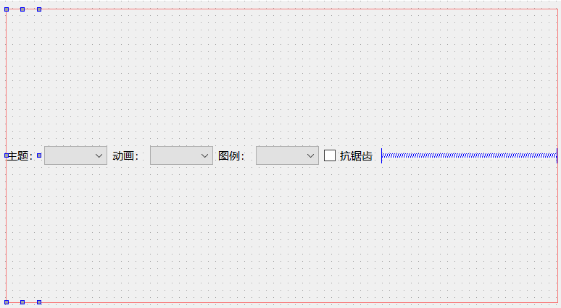
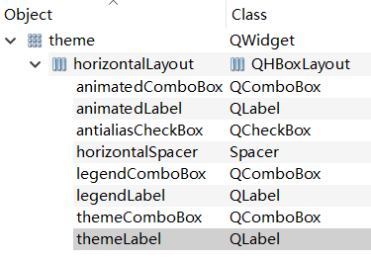
主题设置
为图表设置不同的风格：
1、ui准备
1、数据准备：随机产生三组数据，每组7个。
DataTable Theme::generateRandomData(int listCount, int valueMax, int valueCount) const
{
DataTable dataTable; //typedef QList<DataList> DataTable; // generate random data
for (int i(0); i < listCount; i++) {
DataList dataList;//typedef QList<Data> DataList;
qreal yValue(0);
for (int j(0); j < valueCount; j++) {
yValue +=QRandomGenerator::global()->bounded(1.5); QPointF value(j,yValue);
QString label = "Slice " + QString::number(i) + ":" + QString::number(j);
dataList << Data(value, label);//typedef QPair<QPointF, QString> Data;
}
dataTable << dataList;
} return dataTable;
}

Slide 10
3、框架搭建。
int main(int argc, char *argv[]) {
QApplication a(argc, argv);
MainWindow w;
w.setWindowIcon(QIcon("../images/ball.png"));
Theme *widget = new Theme();
w.setCentralWidget(widget);
w.resize(900, 600); w.show();
w.show(); return a.exec();
}
main
class Theme : public QWidget {
Q_OBJECT
public:
explicit Theme(QWidget *parent = nullptr);
~Theme();
private Q_SLOTS:
void updateUI();
private:
QChart * createAreaChart() const;
DataTable generateRandomData(int listCount, int valueMax, int valueCount) const; void populateThemeBox();
void populateAnimationBox();
void populateLegendBox();
private:
int m_listCount;
int m_valueMax;
int m_valueCount;
DataTable m_dataTable;
QChartView *m_chartView; Ui_theme *ui;
};
Theme声明

Slide 11
Theme构造函数
Theme::Theme(QWidget *parent) :
QWidget(parent),
m_listCount(3),
m_valueMax(10),
m_valueCount(7),
m_dataTable(generateRandomData(m_listCount, m_valueMax, m_valueCount)),
ui(new Ui_theme)
{
ui->setupUi(this);
populateThemeBox();
populateAnimationBox();
populateLegendBox(); m_chartView = new QChartView(createAreaChart());
ui->gridLayout->addWidget(m_chartView, 1, 0); // Set defaults
ui->antialiasCheckBox->setChecked(true); updateUI();
QObject::connect(ui->themeComboBox, SIGNAL(currentIndexChanged(int)),
this, SLOT(updateUI()));
QObject::connect(ui->antialiasCheckBox, SIGNAL(toggled(bool)),
this, SLOT(updateUI()));
QObject::connect(ui->legendComboBox, SIGNAL(currentIndexChanged(int)),
this, SLOT(updateUI()));
QObject::connect(ui->animatedComboBox, SIGNAL(currentIndexChanged(int)),
this, SLOT(updateUI()));
}

Slide 12
Theme：ComboBox初始化
void Theme::populateThemeBox() {
// add items to theme combobox
ui->themeComboBox->addItem("Light", QChart::ChartThemeLight);
ui->themeComboBox->addItem("Blue Cerulean", QChart::ChartThemeBlueCerulean);
ui->themeComboBox->addItem("Dark", QChart::ChartThemeDark);
ui->themeComboBox->addItem("Brown Sand", QChart::ChartThemeBrownSand);
ui->themeComboBox->addItem("Blue NCS", QChart::ChartThemeBlueNcs);
ui->themeComboBox->addItem("High Contrast", QChart::ChartThemeHighContrast);
ui->themeComboBox->addItem("Blue Icy", QChart::ChartThemeBlueIcy);
ui->themeComboBox->addItem("Qt", QChart::ChartThemeQt);
}
void Theme::populateAnimationBox() {
// add items to animation combobox
ui->animatedComboBox->addItem("No Animations", QChart::NoAnimation);
ui->animatedComboBox->addItem("GridAxis Animations", QChart::GridAxisAnimations);
ui->animatedComboBox->addItem("Series Animations", QChart::SeriesAnimations);
ui->animatedComboBox->addItem("All Animations", QChart::AllAnimations);
}
void Theme::populateLegendBox() {
// add items to legend combobox
ui->legendComboBox->addItem("No Legend ", 0);
ui->legendComboBox->addItem("Legend Top", Qt::AlignTop);
ui->legendComboBox->addItem("Legend Bottom", Qt::AlignBottom);
ui->legendComboBox->addItem("Legend Left", Qt::AlignLeft);
ui->legendComboBox->addItem("Legend Right", Qt::AlignRight);
}

Slide 13
Theme创建图表
QChart *Theme::createAreaChart() const {
QChart *chart = new QChart();
chart->setTitle("Area chart"); // The lower series initialized to zero values
QLineSeries *lowerSeries = 0;
QString name("Series ");
int nameIndex = 0;
for (int i(0); i < m_dataTable.count(); i++) {
QLineSeries *upperSeries = new QLineSeries(chart);
for (int j(0); j < m_dataTable[i].count(); j++) {
Data data = m_dataTable[i].at(j);
if (lowerSeries) {
const auto &points = lowerSeries->points();
upperSeries->append(QPointF(j, points[i].y() + data.first.y()));
} else {
upperSeries->append(QPointF(j, data.first.y()));
}
}
QAreaSeries *area = new QAreaSeries(upperSeries, lowerSeries);
area->setName(name + QString::number(nameIndex));
nameIndex++; chart->addSeries(area); lowerSeries = upperSeries;
} chart->createDefaultAxes();
QValueAxis *axisX = qobject_cast<QValueAxis*>(chart->axes(Qt::Horizontal).first());
axisX->setTickCount(m_valueCount);
axisX->setLabelFormat("%d ");
return chart;
}

Slide 14
void Theme::updateUI() {
QChart::ChartTheme theme = static_cast<QChart::ChartTheme>(
ui->themeComboBox->itemData(ui->themeComboBox->currentIndex()).toInt()); m_chartView->chart()->setTheme(theme); // Set palette colors based on selected theme
QPalette pal = qApp->palette();
if (theme == QChart::ChartThemeLight) {
pal.setColor(QPalette::Window, QRgb(0xf0f0f0));
pal.setColor(QPalette::WindowText, QRgb(0x404044));
} else if (theme == QChart::ChartThemeDark) {
pal.setColor(QPalette::Window, QRgb(0x121218));
pal.setColor(QPalette::WindowText, QRgb(0xd6d6d6));
} else if (theme == QChart::ChartThemeBlueCerulean) {
pal.setColor(QPalette::Window, QRgb(0x40434a));
pal.setColor(QPalette::WindowText, QRgb(0xd6d6d6));
} else if (theme == QChart::ChartThemeBrownSand) {
pal.setColor(QPalette::Window, QRgb(0x9e8965));
pal.setColor(QPalette::WindowText, QRgb(0x404044));
} else if (theme == QChart::ChartThemeBlueNcs) {
pal.setColor(QPalette::Window, QRgb(0x018bba));
pal.setColor(QPalette::WindowText, QRgb(0x404044));
} else if (theme == QChart::ChartThemeHighContrast) {
pal.setColor(QPalette::Window, QRgb(0xffab03));
pal.setColor(QPalette::WindowText, QRgb(0x181818));
} else if (theme == QChart::ChartThemeBlueIcy) {
pal.setColor(QPalette::Window, QRgb(0xcee7f0));
pal.setColor(QPalette::WindowText, QRgb(0x404044));
} else {
pal.setColor(QPalette::Window, QRgb(0xf0f0f0));
pal.setColor(QPalette::WindowText, QRgb(0x404044));
}
qApp->setPalette(pal); // Update antialiasing
bool checked = ui->antialiasCheckBox->isChecked();
m_chartView->setRenderHint(QPainter::Antialiasing, checked); // Update animation options
QChart::AnimationOptions options(
ui->animatedComboBox->itemData(ui->animatedComboBox->currentIndex()).toInt()); m_chartView->chart()->setAnimationOptions(options); // Update legend alignment
Qt::Alignment alignment(
ui->legendComboBox->itemData(ui->legendComboBox->currentIndex()).toInt()); if (!alignment) {
m_chartView->chart()->legend()->hide();
} else {
m_chartView->chart()->legend()->setAlignment(alignment);
m_chartView->chart()->legend()->show(); }
}
Theme：更新UI

